Slide 1

Google Play Store Dataset is used to Analyze the Android Market
EXCEL CAPSTONE PROJECT
TOPIC
Submitted By: Shukal Jain

Slide 2
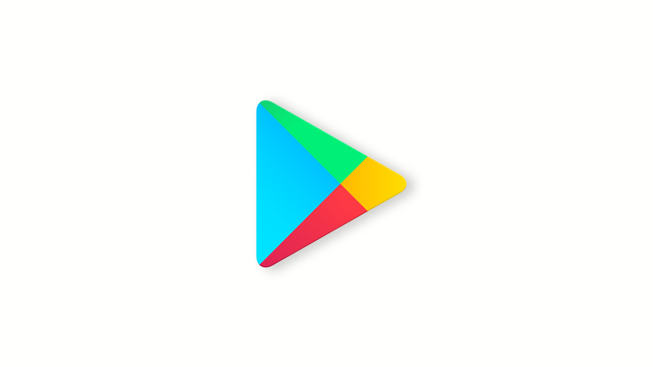
Some basic Information about the Dataset
I have done a analysis on web scraped data of about 10k Play Store apps for analyzing the Android market.
This data set is downloaded from kaggle.com/datasets which contains a .csv file of 1.15 MB.
The file consist of 13 columns and 10,359 rows.

Slide 3
Objectives
Comparison of Free and Paid applications.
Analysis based on different price range in paid applications.
Analysis based on their category.
Classification based on content rating.
Analysis based on Downloads of the applications.
Analysis on the basis of ratings given by the users.
Analysis on the basis of reviews count.
Rating vs. Reviews
Analysis based on size of the applications.
Analysis based on updates of the applications.

Slide 4
Major Categories in Play Store: Free Apps vs. Paid Apps
There are more than 10 thousand Apps available in the Play store .
From which about 9.5K applications are free of cost. Which is 93% of the total application available on the app store.
And there are only about 750 applications are taking some charges from the users. Which is 7% of the total applications are paid .

Slide 5
Some Basic Types of Applications
Here, the Family type Applications have higher app count with 1942 Apps in the free category and paid category.
And in the Medical type, 84 apps are paid out of 408 apps available in this field.
So, it’s about 21% of the apps are paid in the Medical field, which is higher than of other fields.
It means the online medical facilities are more chargeable as compare to the other facilities.

Slide 6
Price range of Paid Applications with average rating on Google Play store
The range of paid applications on Play Store is between 0.99$ to 400$.
There are only 3% of the applications which are too costly which are between 51$ to 400$.
And other 97% of the paid applications are below 50$.
The costliest app in the Play store is “I'm Rich - Trump Edition” which belongs to Lifestyle category of cost 400$.
We can see that the apps with moderate price range having good average rating.

Slide 7
Count of Applications on the basis of their Category
The most number of available applications in the Play Store are from the Family category.
Which is about 19% of the total applications available in the Play Store.
The Game and the Tools categories are also contributing the good number of percentage after Family category.
And the Beauty category has least number of application with 0.51% of total apps.

Slide 8
Classification on the basis of Content Rating
Most of the apps in Play Store are available for all age group.
There are 376 apps which are restricted for age group less than 10 yrs.
There are 447 apps which restricted for age group less than 17 yrs.
There are 1146 apps which are for age group 13 yrs. to 19 yrs. It means for only teenagers.
And there are only 3 apps with the content rating of 18+ .

Slide 9
Categories of Applications with 1 billion+ downloads
So, there are more apps with the Communication category which has more than 1 billion downloads.
After that social category has 7 apps which are with 1 billion+ downloads.
And from the Family and Books Categories there is only 1 application which has more than 1 billion downloads .

Slide 10
Top 10 downloaded Apps in the Play Store
The top most downloaded app in the Play Store is Subway Surfer with about 5 Billion downloads.
The average rating of this app is 4.5. And that comes under the excellent rating.
This application belongs to the Gaming category.
And there are three apps from gaming category which makes there place in Top 10 list.
So, we can say that there is huge craze of gaming amongst the users.

Slide 11
Classification of Apps on the basis of their ratings
The results of this pie chart is depend on the following criteria:
a) The apps which are rated between 1 and 2.5 are with the Poor ratings.
b) The apps which are rated between 2.6 and 4 are with the Average ratings.
c) The apps which are rated between 4.1 and 5 are with the Excellent ratings.
d) There are some apps which did not get any ratings from the users. So, they are in the Not Rated category.
The chart is showing that 62% of apps got Excellent rating. So, most of the apps in the app store are getting positive response from the user.
The 17% of the apps in the play store are with the average rating. Which is not that bad.
And only 1% apps are with the poor rating from the total apps available in the app store. Which is ok.
And 14% of the apps didn’t get any ratings from the users.

Slide 12
The average rating of Play Store
The average rating of Play Store is 4.19. Which is Moderate.
The category having highest average rating is Events with average rating 4.4.
The category having lowest average rating is Dating.
It means that, the experience of the users with the Dating category apps are not good.

Slide 13
Total Reviews on the Play Store from the users
The total number of reviews on the Play store are more than 4 billion.
And the Gaming category has not the maximum number of downloads still it has maximum about 1.4 billion reviews.
Which means people who play games are more active to give feedback as comparison to other category users.

Slide 14
Comparison between Sum of Downloaded Apps and Sum of Reviews to those Apps
There are approx. 144 billion downloads of total apps in the app store.
And the number of total reviews are approx. 4 billion.
So, there are only 3% of the users who are interested in writing reviews .
There should be more feedback counts from the users, so that the organization will try to improve them accordingly.

Slide 15
Range of Application’s size on Play Store
Here we can see that the app with the least size is Libraries_and_demo of 11kb.
And the maximum size of apps in the Play Store is 100mb.
There are 16 applications with the size of 100mb.
And Gaming category has largest no. of greater size apps as comparison to other categories.

Slide 16
Percentage of Apps updated in recent years and their average rating
We can see that the year by year the percentage of updated apps are increasing.
And we can see that the most of the apps are updated in 2018. That’s why this year has the highest average rating of 4.24%.
It means the apps which are updated in very recent year are getting good ratings from the users.

Slide 17
Conclusion
The 93% of the total application are free of cost on the app store.
The online medical facilities are more chargeable as compare to the other facilities.
The costliest app in the Play store is “I'm Rich - Trump Edition” which belongs to Lifestyle category of cost 400$
The apps with moderate price range having good average rating.
The most of the apps available on Play Store are from Family, Gaming and Tools category.
Most of the apps in Play Store are available for all age group.
Subway Surfer is the most downloaded app in the Play store with about 5 billion downloads . So, there is huge craze of this game amongst the users.
The average rating of the Play Store is 4.19.
The total reviews on the Play Store are about 4 billion .
And the 1.4 billion reviews are from Game category users. So, we can say that the people who play games are more active to give feedback as comparison to other category users.
The total count of reviews on the Play Store are about 3% of the total count of the downloaded apps on the Play store. It means very few people who are taking interest in giving their feedback.
It is observed that the apps which are updated in very recent year are getting good ratings from the users.
Range of application’s size on the Play Store is from 11 Kb to 100 Mb.

Slide 18
THANK YOU

